Slide 1
Small Hydro

Slide 2
Classification
Dependent on Capacity:
Depending on Head:
Size | Unit size
Micro | Upto 100 kW
Mini | 101 to 1000 kW
Small | 1001 to 6000 kW
Ultra low head | Below 3 m
Low head | Less than 30 m
Medium head | Between 30 to 75 m
High head | Above 75 m

Slide 3
Schemes for small hydro
Independent scheme
Sub ordinate scheme

Slide 4
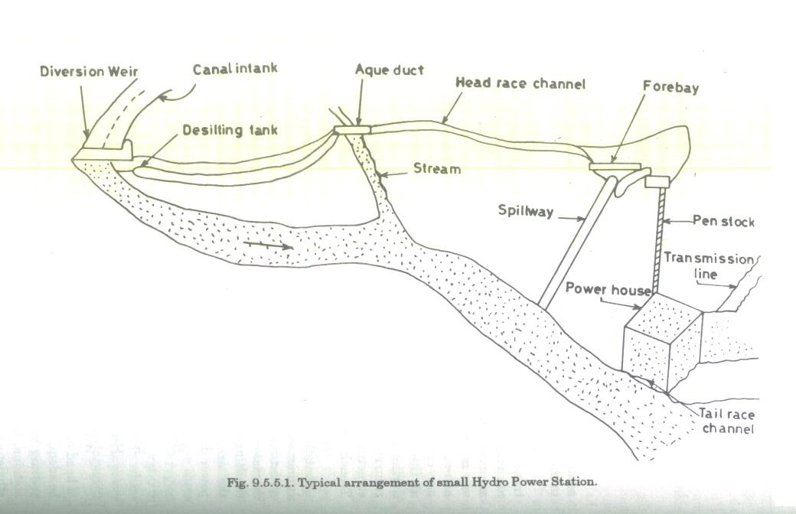

Slide 5
Components of a hydroelectric scheme
Diversion and intake
Desilting chamber
Water conductor system
Forebay / balancing reservoir
Surgetank
Penstock
Powerhouse – turbine, generator etc.
Tail race channel

Slide 6
Turbines and Generators for small hydro
Bulb or tubular turbine
Tube turbine
Straflo turbine

Slide 7
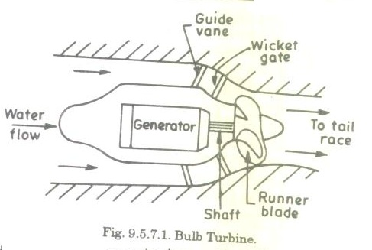

Slide 8
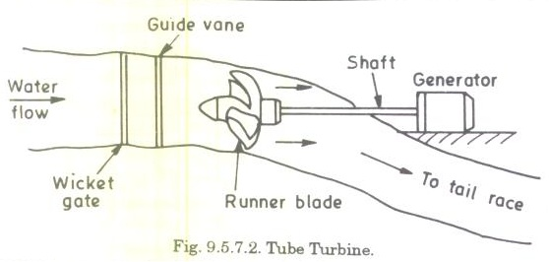

Slide 9
THANK YOU

